Slide 1

Blood Group Detection Using Fingerprint Patterns - A Deep Learning Approach
Authors : Rohit Kandelkar, Yash Jahagirdar, Anandkumar Birajdar, Sukanya Bhaskar, and Rajeshwari Golande
Department Of Computer Engineering (Regional Language)
Pimpri Chinchwad College of Engineering (PCCOE), Pune

Slide 2
1. AGENDA
Abstract
Introduction
Literature Review
Research Gaps
Methodology
Results & Discussion
Comparative Analysis
Conclusion & Future Work
References

Slide 3
2. ABSTRACT
Problem: Traditional blood typing methods are accurate but are invasive, slow, and require significant resources.
Method: Proposed a non-invasive approach to classify blood groups using fingerprint patterns and various Convolutional Neural Network (CNN) architectures.
Key Results: A Shallow CNN outperformed more complex models, achieving the highest accuracy of 89.49% with a significantly faster training time.
Impact: This research demonstrates a promising, non-invasive, and cost-effective alternative to conventional blood typing.

Slide 4
3. INTRODUCTION
The Gap in Previous Research: Early attempts to use biometrics for this task relied on traditional machine learning (SVM, KNN). These methods suffered from:
Poor accuracy (generally below 80%).
High sensitivity to image noise.
Limited ability to generalize from small datasets.
Our Approach: This study proposes a modern, non-invasive solution using Convolutional Neural Networks (CNNs) to accurately and efficiently classify blood groups directly from fingerprint images.
The Foundation: Fingerprints are a cornerstone of biometric identification. Emerging research suggests a potential link between their unique patterns and genetic traits, including blood groups.
The Problem: Conventional blood typing methods are accurate but have significant drawbacks:
Invasive: They require physical blood samples.
Time-Consuming & Resource-Intensive: Not ideal for emergencies, remote healthcare, or large-scale screening.

Slide 5
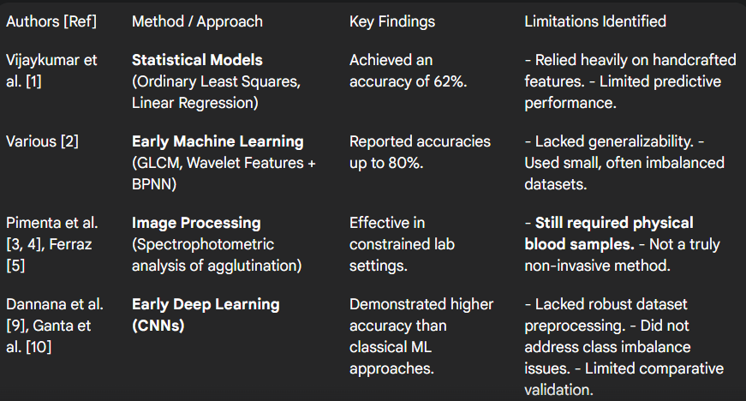
4. LITERATURE REVIEW

Slide 6
5. RESEARCH GAPS
Inadequate Preprocessing in Prior Work: Many previous studies failed to address significant dataset issues, particularly class imbalance, which leads to biased and unreliable model performance.
Lack of Standardized Baselines: Earlier papers often presented results for a single model without a fair, controlled comparison against other architectures, making it difficult to validate their claims of superiority.
Limited Accuracy of Traditional Methods: Non-deep-learning approaches (like SVM, KNN) consistently failed to achieve accuracies above 80% and lacked the ability to generalize well.
Insufficient Methodological Transparency: A common issue in prior research is the lack of detailed reporting on dataset sources, preprocessing pipelines, and model configurations, which hinders reproducibility.
Unexplored Trade-off Between Complexity and Performance: There was an assumption that deeper, more complex models are always better. The effectiveness of a well-optimized, simple architecture had not been thoroughly investigated.

Slide 7
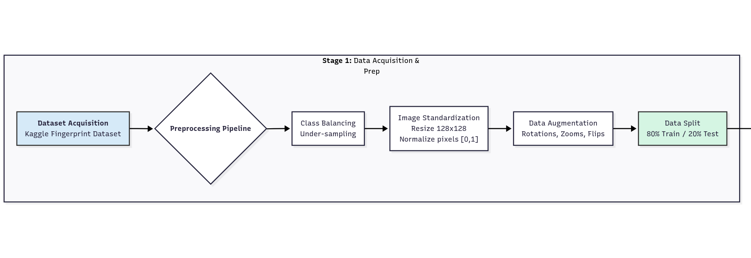



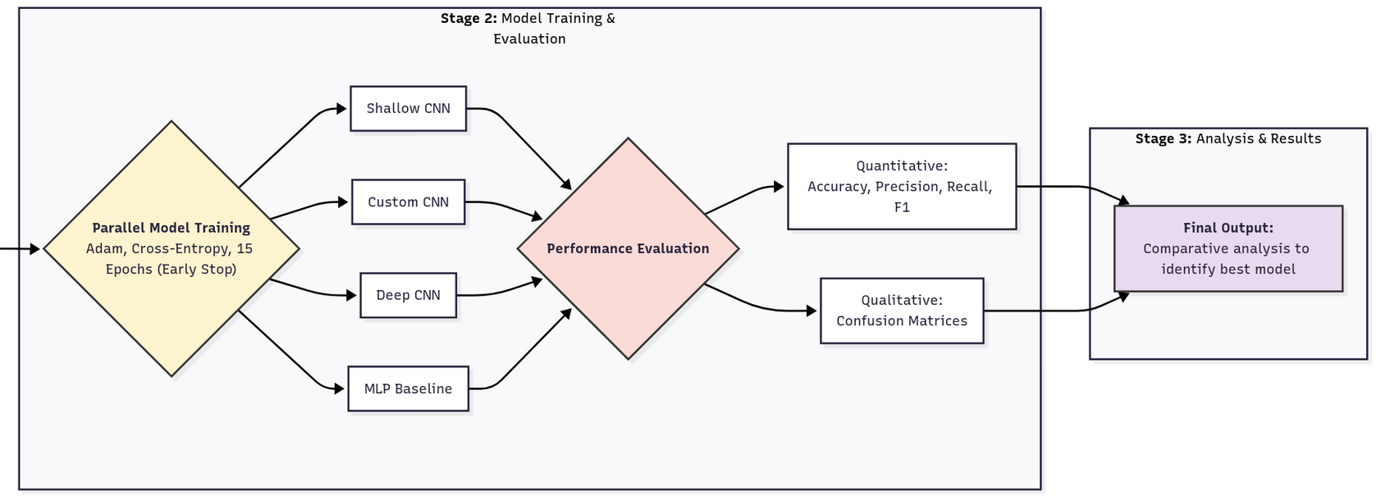
6. METHODOLOGICAL WORKFLOW

Slide 8
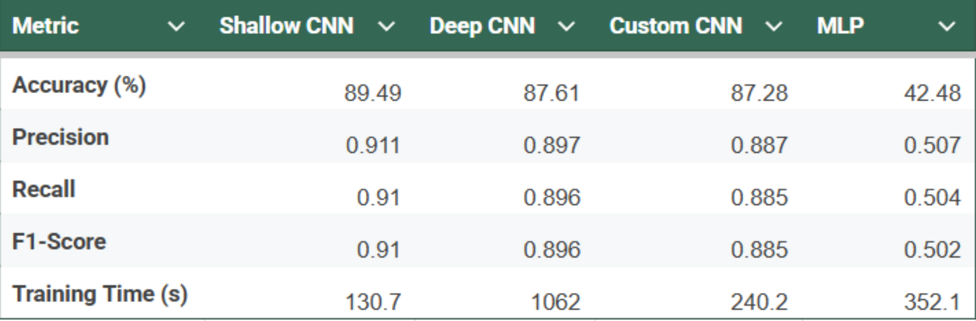
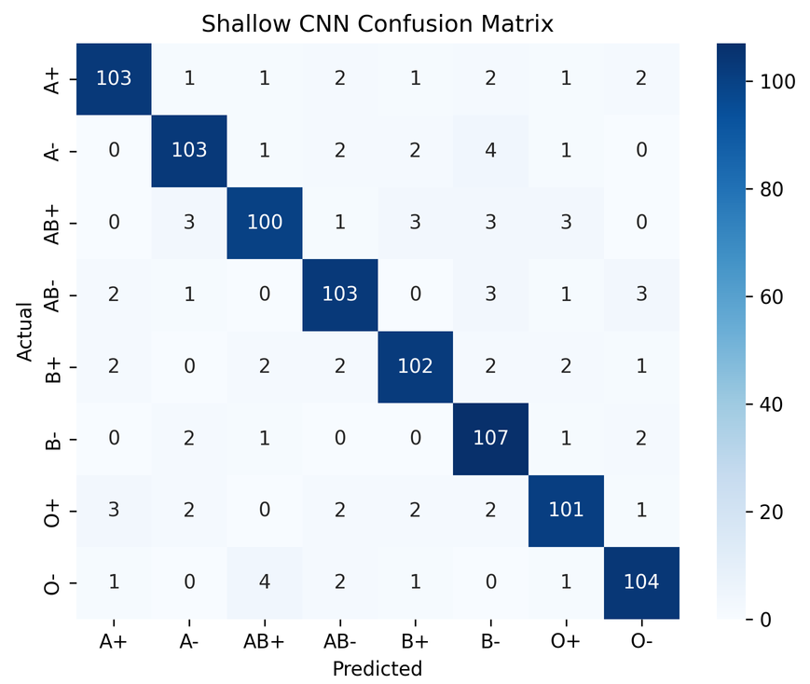
7. RESULTS & DISCUSSION
The Shallow CNN model achieved the highest accuracy and F1-Score with the fastest training time. The confusion matrix shows a strong diagonal, indicating balanced and accurate predictions across all blood groups.

Slide 9
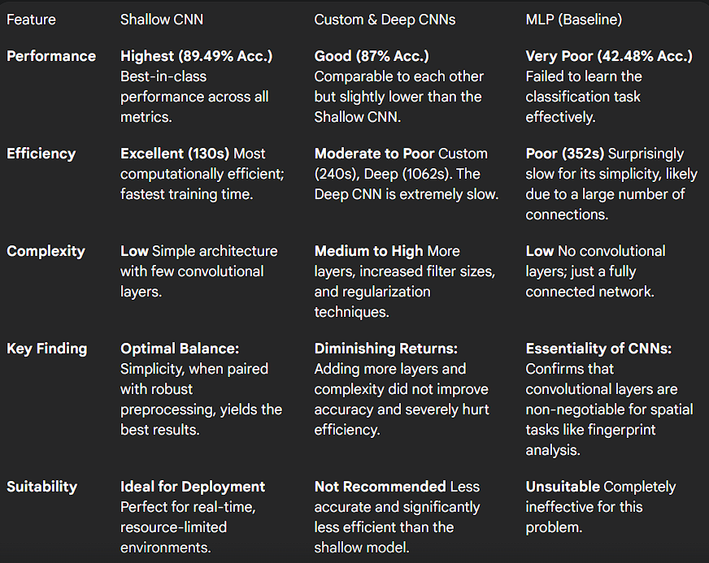
8. COMPARATIVE ANALYSIS

Slide 10
9. CONCLUSION
This research developed a non-invasive blood group classification method using fingerprints, achieving 89.49% accuracy. The Shallow CNN model outperformed more complex architectures in both accuracy and efficiency, challenging the notion that "deeper is always better." The method provides a reproducible, scalable alternative to traditional serological testing.
FUTURE WORK
Enhance Dataset: Include more diverse fingerprint samples for better generalizability.
Explore Transfer Learning: Use pre-trained models like VGG16 or ResNet to improve accuracy.
Real-World Validation: Test the model in clinical or forensic settings.
Improve Interpretability: Use Grad-CAM to visualize model decision-making for better transparency.

Slide 11
10. REFERENCES
[1] Vijaykumar, Patil N., and D. R. Ingle, "A Novel Approach to Predict Blood Group using Fingerprint Map Reading," 2021 6th International Conference for Convergence in Technology (I2CT), IEEE, 2021.
[2] D. Siva Sundhara Raja and J. Abinaya, "A Cost-Effective Method for Blood Group Detection Using Fingerprints," International Journal of Advance Study and Research Work, vol. 2, no. 3, pp. 1-10, March 2019.
[3] S. Pimenta, G. Minas and F. Soares, "Spectrophotometric approach for automatic human blood typing," 2012 IEEE 2nd Portuguese Meeting in Bioengineering (ENBENG), Coimbra, Portugal, 2012, pp. 1-4.
[4] A. Ferraz, "Automatic system for determination of blood types using image processing techniques," 2013 IEEE 3rd Portuguese Meeting in Bioengineering (ENBENG), IEEE, 2013.
[5] S. Dannana and D. Y. V. Prasad, "Blood group detection using ML classifier," International Journal of Health Sciences, vol. 6, Suppl. 1, pp. 4395-4408, 2022.
[6] J. Sai Ganta, M. Rishitha, Y. Jaya Surya Pulivarthi, and M. Roopa, "Blood Group Detection Using Image Processing and Deep Learning," International Research Journal of Engineering and Technology (IRJET), vol. 11, no. 4, pp. 97-103, April 2024.

